Slide 1
Restaurant Ordering System
A simple solution to common problems
Presented by Calder, Xenon, Nguyen, Shawn
Notes:
Hello everyone, we are group 4, and Our project idea was to make a restaurant ordering system. Now, an ordering system is the process of the restaurant making an order to a supplier, who then delivers the order to the restaurant after some amount of time. The exacts of this operation can vary, but generally it follows that rule. So we have decided to make a system to assist and streamline this procedure.

Slide 2
What is the system, and how does it do it?
What is the objective of the system?
Notes:
So, the objective of the system. Simply put, it’s to let people order inventory items through the use of a computer with an online connection.
And with this objective, we now have to ask ourselves “how do we complete our objective?”(show second point).

Slide 3
What is the system, and how does it do it?
What is the objective of the system?
How does the system allow you to complete the objective?
Notes:
This is accomplished by the use of a website that is connected to the supplier. The user can use various forms on this website to add and remove items in an order and have that order be automatically sent to the supplier. The website is also capable of assisting the user to complete this objective in other ways, and now to talk about the problems and primary tasks of the system: Nguyen.

Slide 4
Problem: Making a restaurant backend ordering system
Restaurant Backend Ordering:
Regular and Special Supplies
Current order
History
Options (Order Settings)
Login page (registered customer)
5 Primary Tasks
Notes:
Nguyen
Note: Introduce the major problem and identify the primary tasks for this problem.
Primary Tasks include regular, special supplies, current order, history, options and login page

Slide 5
Issues & Solutions
Issues | Solutions
Big image in the login page | Removed
No pricing information | Added
The box holding items is small | Fixed
Unhide password | Fixed
Functions working incorrectly | Fixed
Notes:
Nguyen
Note: Expressing the issues that group had during the prototype. Giving solutions after developing the prototype

Slide 6
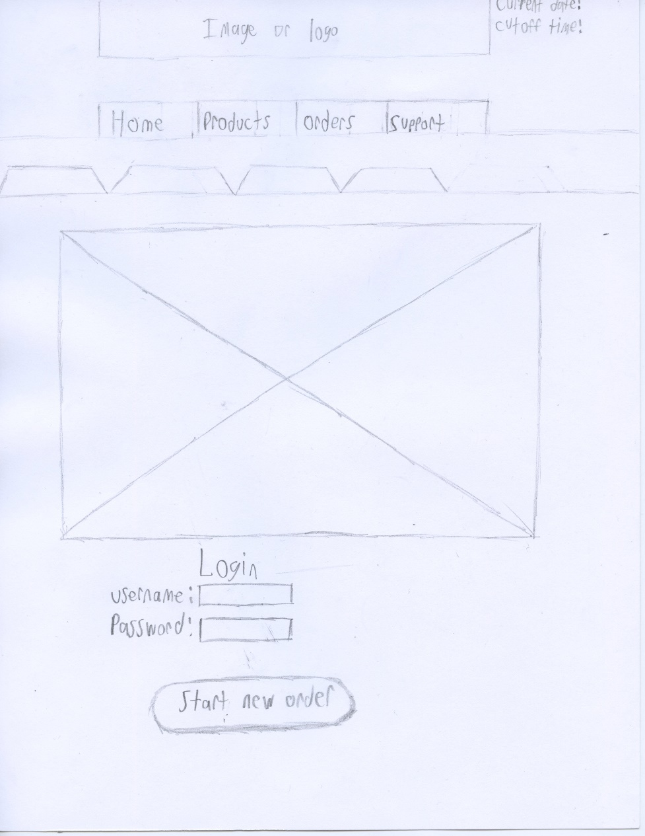
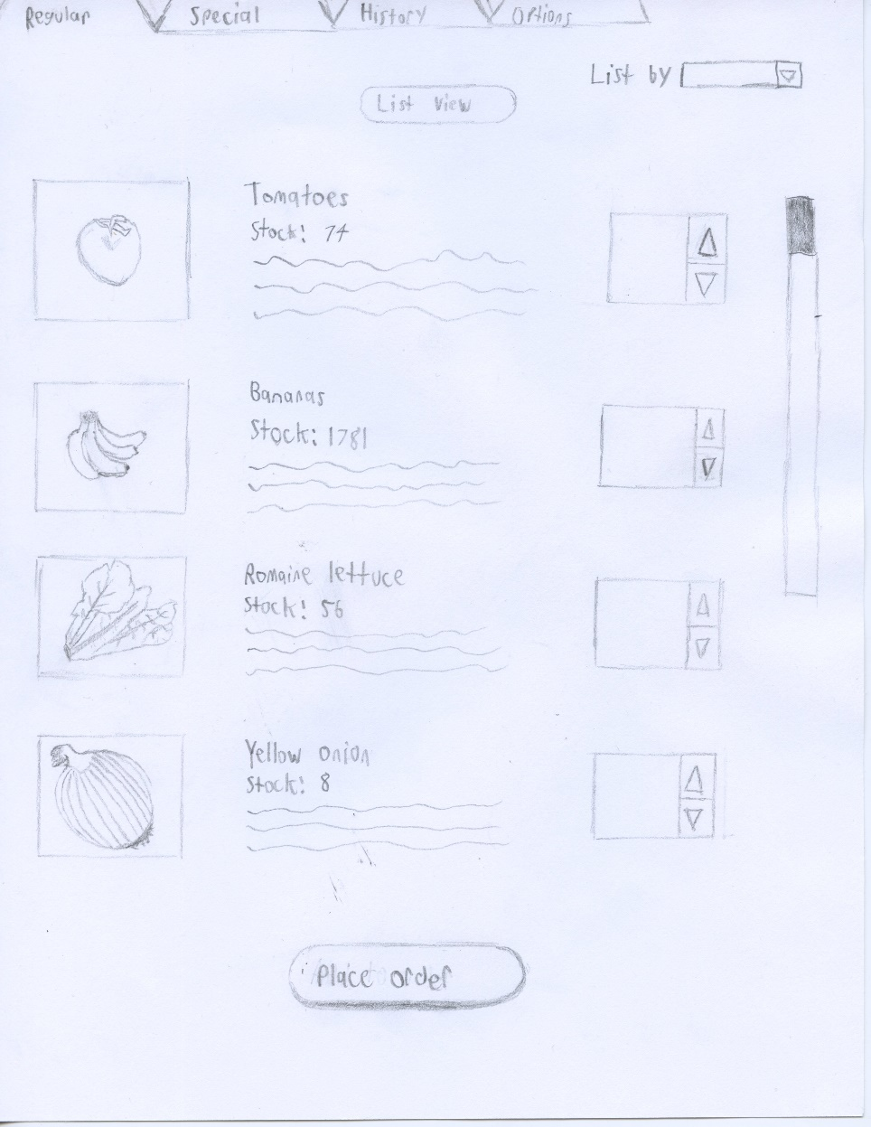
Notes:
Nguyen
Note:
Prototype pictures/sketches to show the issue

Slide 7
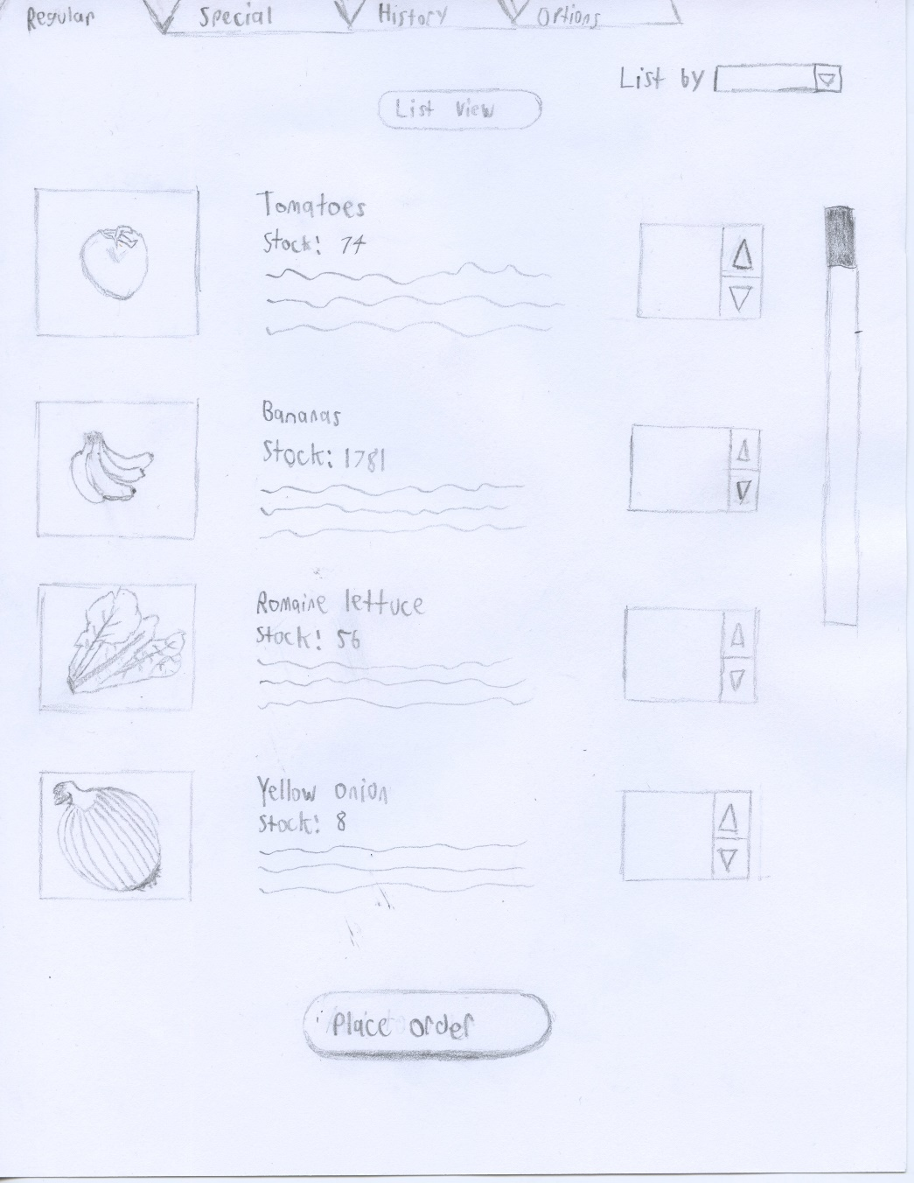
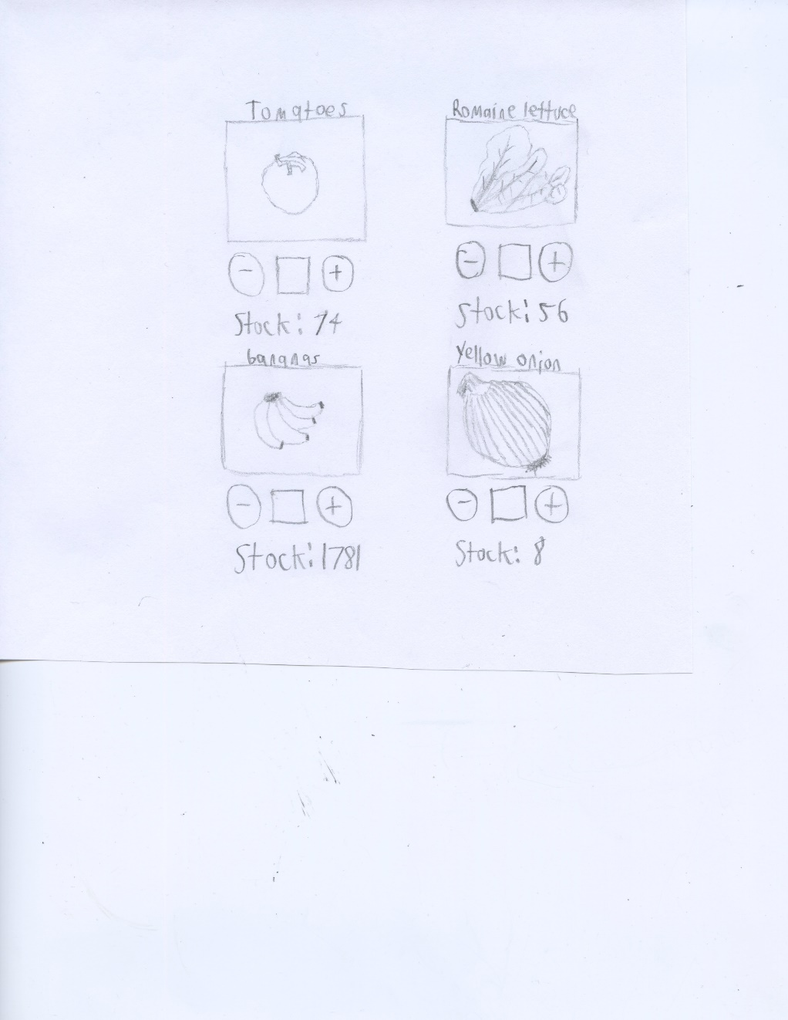
Notes:
Nguyen
Note:
Prototype pictures/sketches to show the issue

Slide 8
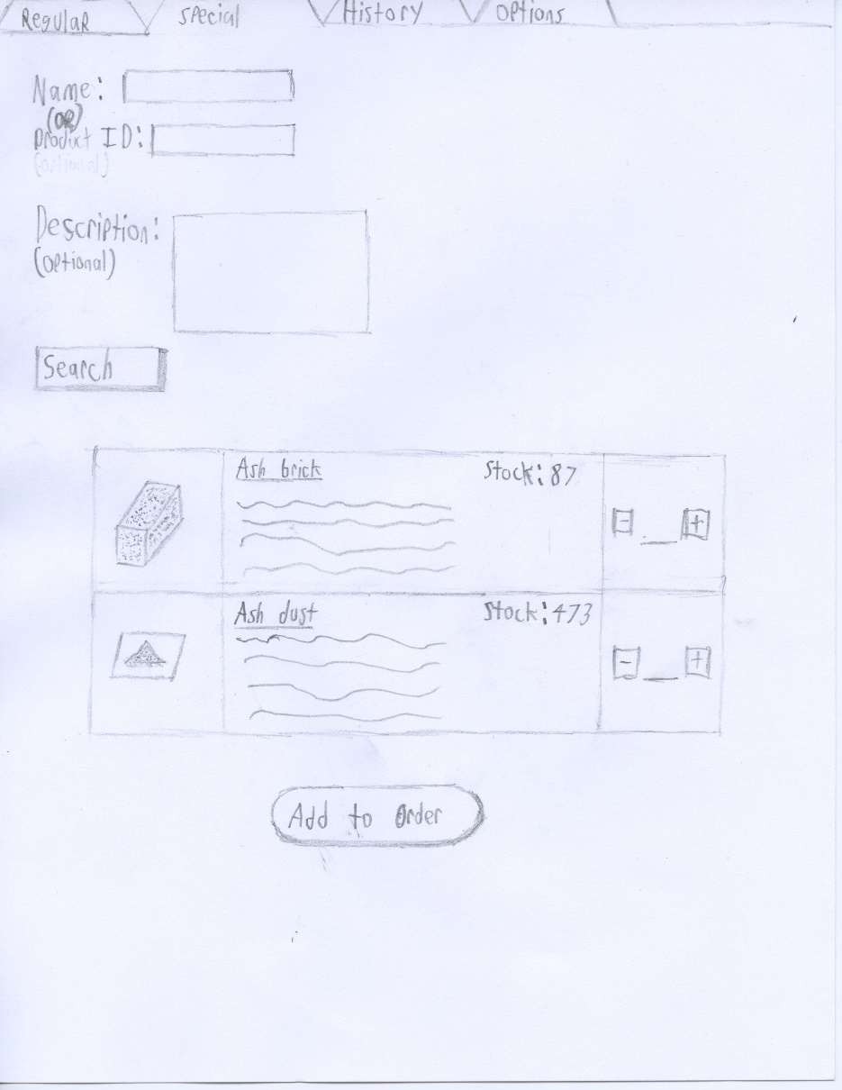
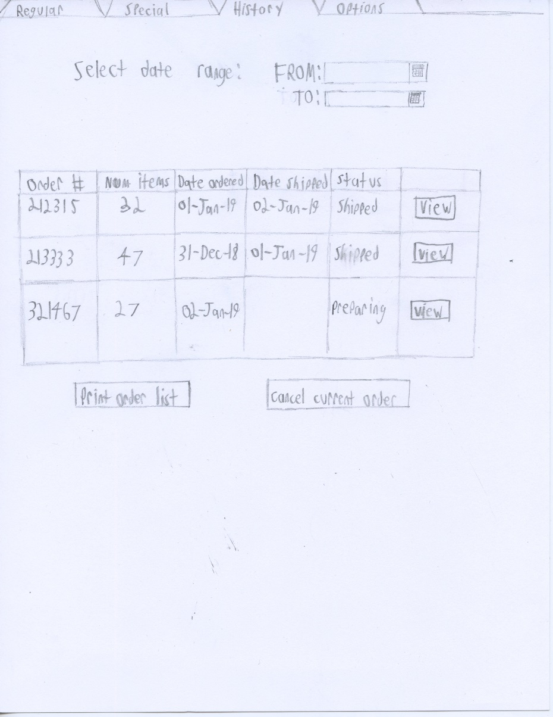
Notes:
Nguyen
Note:
Prototype pictures/sketches to show the issue

Slide 9
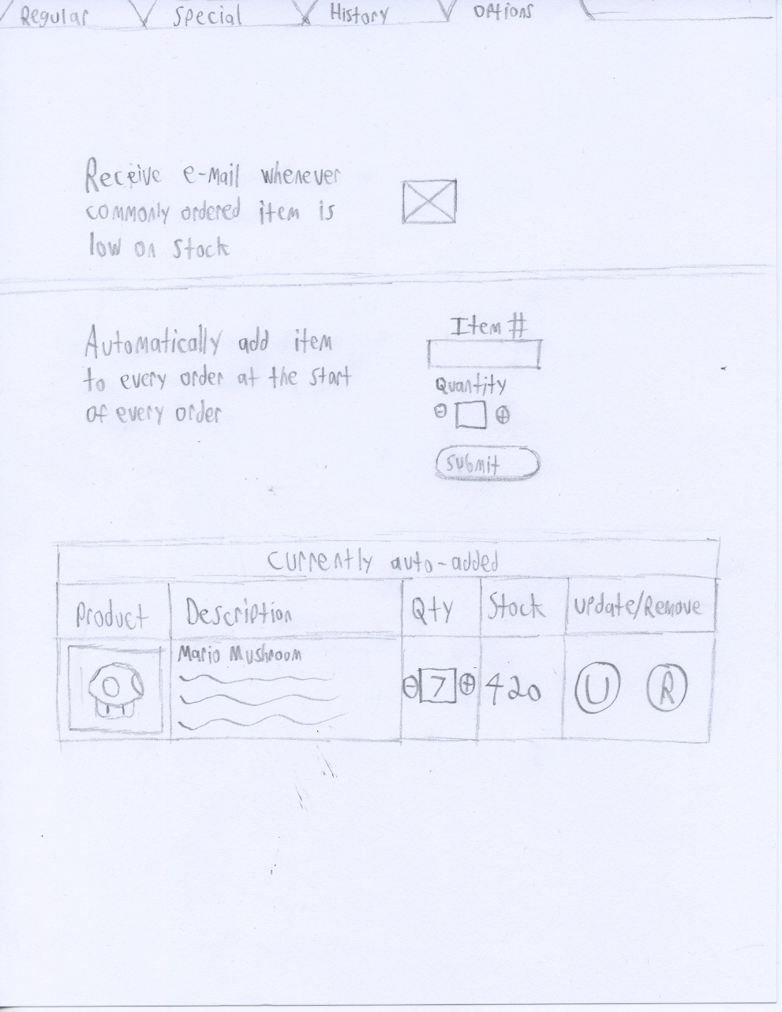
Notes:
Nguyen
Note:
Prototype pictures/sketches to show the issue

Slide 10
Key Interview Points
“…I wish some things were automatic. The computer system is super old and annoying to work with.”
“…the interface is my most concern. Interface must be simple and easy for user to use. “
“Online and connectivity issues arise, no email confirmation …”

Slide 11
Design Choices
Images for items
Color Scheme
How to Search

Slide 12
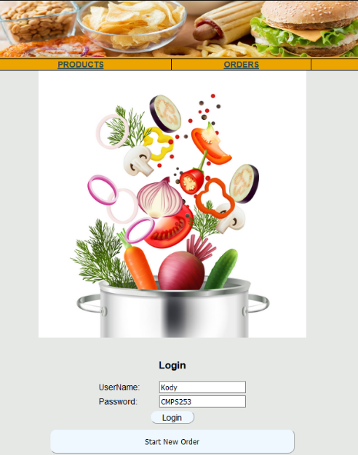
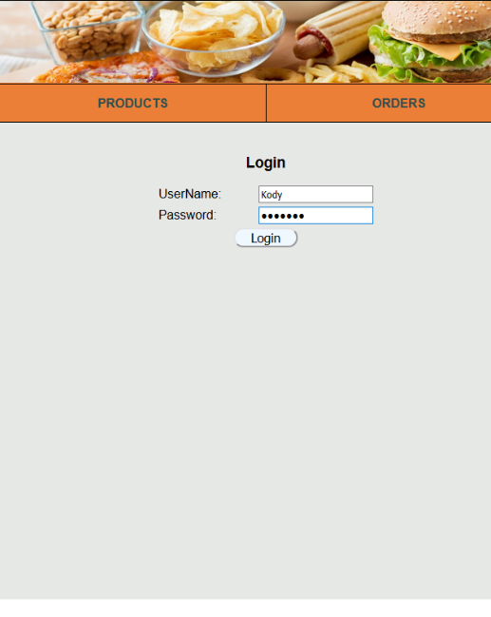
Prototype Version 1 vs. Prototype Version 2
Old Home Page
New Home Page
Notes:
The old home page had a giant image on the middle of the page which made it so that the login fields were at the bottom of the page. Also, the password field in the login wasn’t hiding the input text which was a security flaw, and the “Start New Order” button appeared BEFORE the user was logged in.
In the new version of the page, the giant image was removed, which brought the login fields up to the top of the page. The password field is hidden, and the “Start New Order” button only appears once the user logs in.

Slide 13
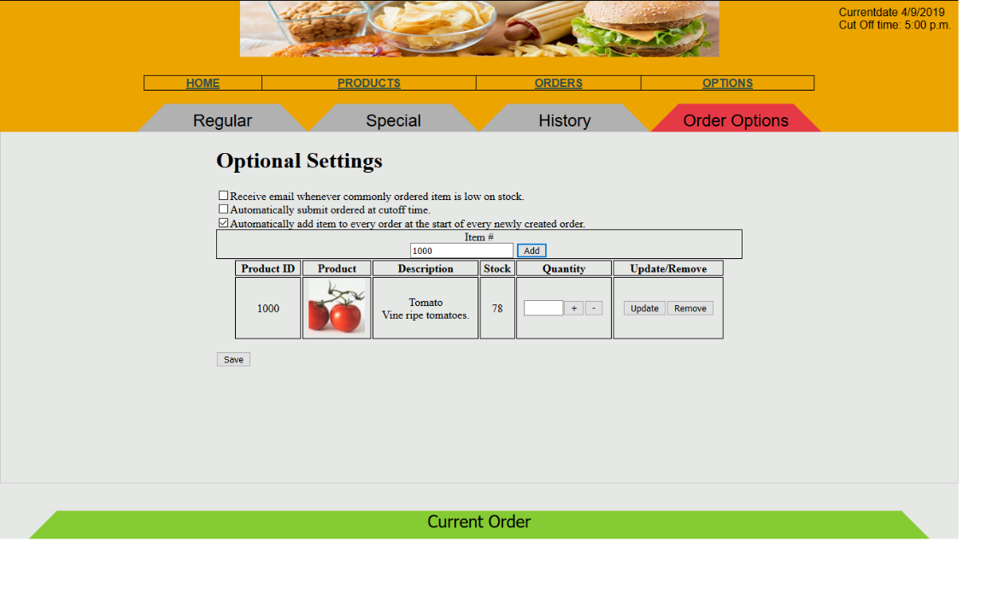
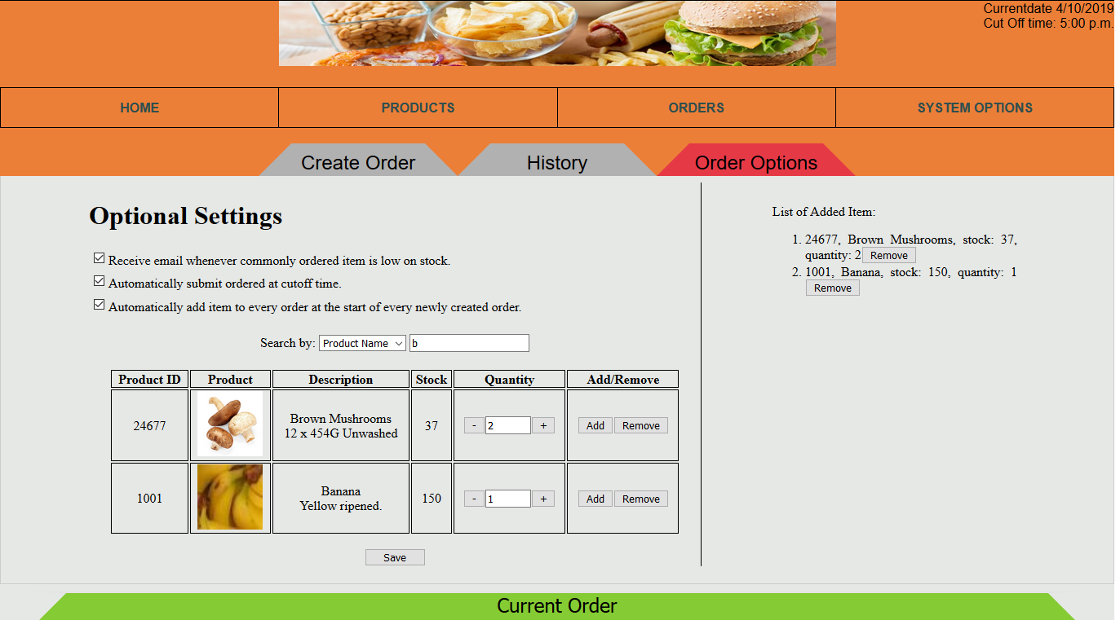
Prototype Version 1 vs. Prototype Version 2
Old Order Options Page
New Order Options Page
Get from Nguyen
Notes:
In the old Order Options page, the user was required to enter in the exact item # of a product in order to add it the order list.
We found that this was relying too much on user’s memory. In the new version, the user can type in the product ID, product name, or description, and search results will appear even for partial matches of the name.
Additionally, in the new version there is now a list on the side of the screen that shows a complete list of which products will be added automatically to every created order.

Slide 14
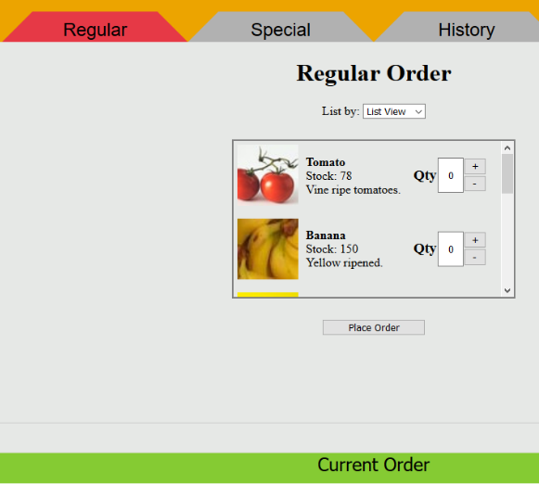
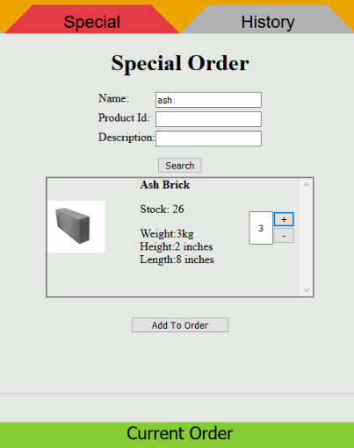
Prototype Version 1 vs. Prototype Version 2
Old Regular Order Page
Old Special Order Page
Notes:
In the previous prototype, the ordering process was split into two pages: Regular and Special. The Regular order page was designed for making a product order that would be ordered regularly by a business.
The Special Order page was made to search for an item that wasn’t in the regular product list and would have to be brought in with a custom order.

Slide 15
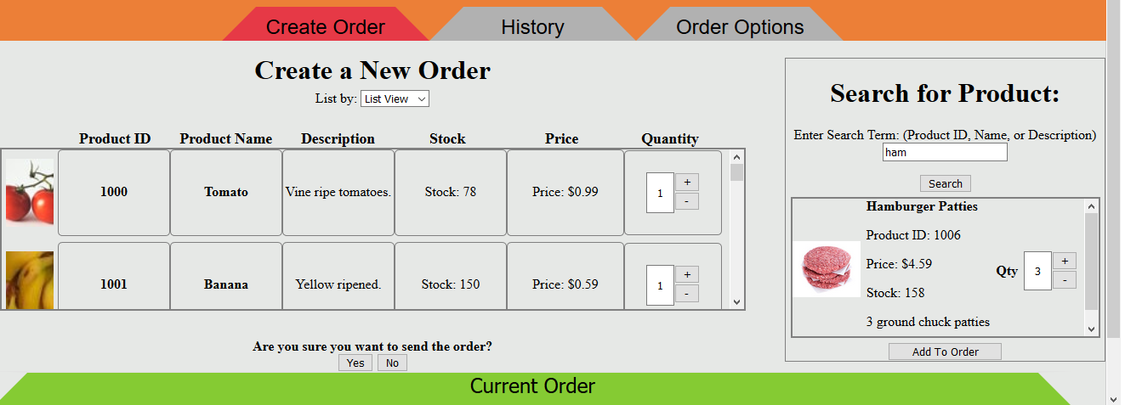
Prototype Version 1 vs. Prototype Version 2
New “Create Order” page
Notes:
In the new version of the system, the “Regular” and “Special” order pages are combined into one “Create Order” page, so that the user doesn’t have to switch back and forth between pages.
The pricing information is displayed for each product in the list view and also in the search box, and products are ordered by product ID in the List View.
The new version also has searching by keyword, which means that you don’t have to specifically choose which criteria to search to by. There is also a confirmation before the order is sent, so it’s not sent accidentally.

Slide 16
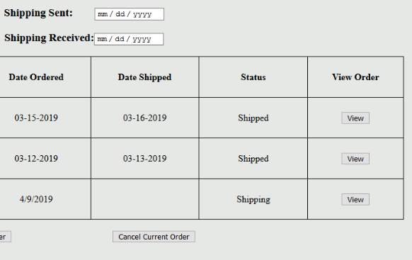
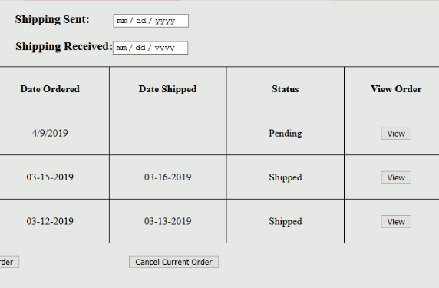
Prototype Version 1 vs. Prototype Version 2
Old Order History Page
New Order History Page
Notes:
On the “Order History” page, the current status of a single order in the list was updated from the previous version to show “Pending” instead of “Shipping” to more accurately reflect the state of the order.

Slide 17
Future Considerations
Add functionality to System Options.
Add support options for the user (phone number to call, email)
Make the system responsive.
Add functionality so that an item can be automatically ordered without sending an order manually.

